Slide 1
Legally Defensible Assessments
October 2016
Presented by:
Marcy L. Gutierrez
Notes:
Cover Page – we are still waiting on approval

Slide 2
LEGALLY DEFENSIBLE
ASSESSMENTS
Notes:
Divider Slide
2

Slide 3
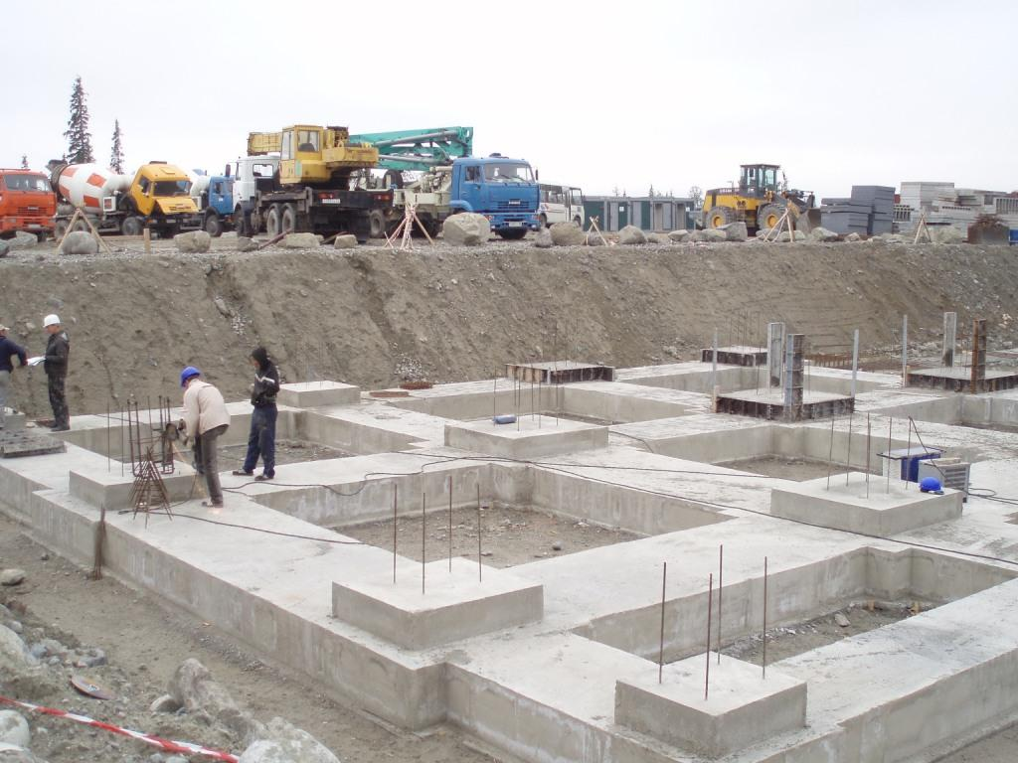
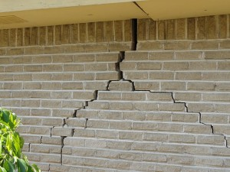
Special Education Assessments
Assessments:
  They are the foundation for eligibility, services and placement.
Notes:
A weak foundation compromises everything else.
A strong foundation sets the course for success.

Slide 4


Child Find - Opportunity
Legal benefits of good assessment include:
  First look at a student.
  Legally defensible report in file.
  Independent Education Evaluation (IEE) issues.
___
…next two years

Slide 5

Child Find - Reassessment
Obligation to assess not extinguished by completion of initial assessment:
  Reassess every three years
  (Ed. Code § 56381(a)(2))
If conditions warrant reassessment.
Notes:
5
Do a triennial assessments have to include standardized tests?
Not necessarily, especially if team, after reviewing existing data decides no more data is needed. EC 56381(d).
DUE comment: I was involved in a district court appeal where Tania Whiteleather argued that the district was required to conduct standardized assessments as part of its tri – district court said no such requirement.

Slide 6

Assessments
The IDEA obligates districts to assess students in all areas of suspected disabilities.
(20 U.S.C. § 1414(b)(3)(B) and Ed. Code, § 56320(f).)
Unique needs are to be broadly construed.
Notes:
6
6
To include the child’s academic, social, health, emotional, communicative, physical, and vocational needs. (Seattle SD No. 1 v. B.S. (9th Cir. 1996) 82 F.3d 1493, 1500.)
Discuss or ask audience:
“How do you determine what areas you will assess?”
Answers should include:
Assessment Plan
Parent interview (discuss)
Teacher interview
Follow up on leads and mysteries
If something in your assessment raises the possibility of further areas of disability, assess in that area

Slide 7

Referral for Assessment
Question: When is it time to refer a child for a special education assessment?

Slide 8
Assessments
Considerations:
Social emotional difficulties.
Attendance issues.
Low academic skills.
Slow progress.
Atypical development.
Behavior that may be triggered by disability.
  Speech disorder leads to frustration leads to behavior problems.

Slide 9
Assessments
A legally defensible assessment includes:
  review of records.
  standardized testing.
  observations in multiple settings.
  parent/teacher interview.
  student interview.
Notes:
REFER TO ONE-SHEET
Start with a record review
Helps indentify areas of disability
Important background
Can support results or raise issues where further assessment may be needed
When assessing non-academic needs, standardized tests alone are not likely to be sufficient.
Emphasize observations.
Allow sufficient time for all aspects of the assessment

Slide 10
Legally Defensible Assessments
Procedural requirements:
Are district’s responsibility/obligation.
Staff must know timelines.
Can make or break a case.
Follow-up is key.
  (20 U.S.C. § 1414(a)(1)(C) and
  Ed. Code, § § 56302.1 and 56043(c).)
Notes:
10
10
15 days for assessment plan
60 days for receipt of consent – convene IEP
KEY: Keep all documentation, email, texts, etc.

Slide 11

Assessments – Potential Blind Spots
Often overlooked areas:
  Behavior.
  Attention.
  Medical.
  Social/Emotional.
  Communication.

Slide 12

Assessments Requirements
Tests and other assessments must be:
  In the language and form most likely to yield accurate information.
  Used for valid and reliable purposes.
  (Ed. Code § 56320)

Slide 13
Assessment Requirements
Administered by trained and knowledgeable personnel and in accordance with the instructions.
Cannot be racially, culturally, or sexually discriminatory.
(Ed. Code § 56320)
Notes:
13
Administered by trained and knowledge personnel and in accordance with any instructions provided
See Anaheim City School District v. Student, OAH Case No.2010010357 (ALJ found Dr. Lauren Franke – a well known independent evaluator - was not qualified to do a psycho-ed assessment because she did not have a credential) – WILL DISCUSS THIS CASE IN A LATER SLIDE ABOUT SCORING AS DR. FRANKE MADE NUMEROUS SCORING ERRORS
Testing and assessment materials and procedures cannot be racially, culturally, or sexually discriminatory
Don’t let an assessor use an instrument they have not been trained to administer
One person may receive training and train others to administer

Slide 14
Assessment Requirements
Tailored to assess the specific areas of educational need and not just a single general intelligence quotient.
Do not use a single measure or assessment as the sole criterion.
(Ed. Code § 56320)
Notes:
14
Tests and other assessment materials include those tailored to assess the specific areas of educational need and not just a single general intelligence quotient
No single procedure may be used as the sole criterion for determining:
whether the student has a disability, or an appropriate educational program for the student
(20 U.S.C. § 1414(b)(2)(B); Ed Code § 56320, subd. (e).)
Cross-reference
E.g. Woodcock Johnsons scores were consistent w/curriculum measures and/or grades
E.g. Pragmatics testing consistent with observations of student conversing with peers

Slide 15

Assessments
Observation:
Observations in the education setting are critical to an appropriate assessment.
Who should observe?
Notes:
The public agency must ensure that the child is observed in the child’s learning environment (including the regular classroom setting) to document the child’s academic performance and behavior in the areas of difficulty. 34 C.F.R. 300.310(a)
What does “regular classroom” mean – doesn’t literally mean gen ed if they are not in that environment.
Recent 9th Circ (unpublished) decision out of Hawaii – Dep’t of Educ v. Patrick P, et al (9th Cir. Unpub. July 14, 2015) 115 LRP 31096:
Student was in12th grade, attending private school. Had previously been eligible for sped, but was exited and not currently eligible.
DOE re-assessed at parent request. Assessor observed twice at the private school. IEP team again found student not eligible.
Parents filed for DPH re: eligibility & private school tuition.
Hearing office found student should be eligible, and that the observations of student in private school did not meet legal requirements. Ninth circ reversed, finding that hearing officer decision was wrong and not entitled to deference.
Excerpt:
The Hearings Officer concluded that the observations of Student in the Private School, a school exclusively for students with special needs, were not observations occurring in "the regular classroom setting" and, thus, were uninstructive for purposes of determining whether Student has a disability. [Decision at 25-26.] Indeed, the Hearings Officer further concluded that "there is no regular classroom setting at the Private School." [Id. at 25.] The Court finds no legal support for such conclusions.
The DOE conducted two fifty-minute observations of Student in his regular classroom. During the first observation, Student was observed working on a class assignment individually on his laptop computer and participating in a class discussion. Student was permitted to use a laptop and allowed to stand up and walk around to facilitate thinking, but no other accommodations were observed. Student was able to display appropriate work and classroom behavior and perform appropriately both academically and socially. [ROA, TR. Vol. II, at 231-36.] During the second observation, Student participated in a class discussion of The Great Gatsby, and his answers to questions indicated that he fully comprehended the passages being discussed. Student was given additional time to work on a vocabulary worksheet; however, no other modifications or accommodations were observed, and Student's special learning needs were not evident. [Id. at 237-43.]
The Court disagrees with the Hearings Officer that these observations should not be given weight because Student was observed in his classroom at the Private School. This was Student's normal classroom setting. Indeed, because Student's regular teacher was absent during the initial observation, the DOE conducted a second observation to observe Student in his usual classroom setting with his customary teacher. [Id. at 237.] The Court can find no support for the proposition that the DOE was somehow required to observe Student in a classroom other than his own regular classroom.
In a footnote: Indeed, if the Hearings Officer's logic is followed, then "regular classroom setting" would entail taking Student out of his classroom at the Private School, where he has attended for years, and placing him in a classroom at a pubic school, where he has never attended class, for observation or finding that, because of the Private School placement, Student is incapable of being observed in a "regular classroom setting". Both scenarios do violence to the regulation and are counterproductive in evaluating Student's eligibility.

Slide 16
Assessments
Observations in other relevant areas:
  Lunch room.
  Assembly/auditorium.
  Video from home, in some cases.
  Observe in a variety of settings.
Notes:
*Discuss – how do you observe child in online charter school, independent study, home hospital, etc ? What if parent doesn’t allow it?

Slide 17
Assessments
Observation:
Easy access to the school setting and staff is a key advantage that district assessments have over private assessments.
Conversely, failure to observe and consult with staff can seriously weaken the credibility of a district assessment.
Notes:
Example – private assessors who did not observe, or otherwise obtain any information from school staff about the child.
**Also, note in report (discussed later), dates, location, duration of observation.
**perhaps discuss here, on the flip side, can parents observe the assessment being done? See recent case, R.A. v. West Contra Costa USD 66 IDELR 36

Slide 18

Assessment Reports
The report shall include,
but is not limited to:
Need for special education and related
services,
(2) Basis for determination,
(Ed. Code § 56327)
Notes:
18
Under the law, this is what must be included in assessment reports
- NEED FOR SPED: See Stanislaus Union School District v. Student, OAH CASE NO. 2013050308 again at pages 35-36.
“Although District’s psychoeducational assessment complied with the law, District committed a procedural violation because the assessor, school psychologist Ms. Harris, did not provide her opinion or recommendation regarding whether Student may need special education, and the basis of that determination under any category of eligibility in her written report. The written report failed to expressly address and analyze any of the eligibility criteria and relate the assessment results to those criteria and denied the IEP team, including Parents, that written information.
However, this procedural violation did not result in a denial of FAPE. Ms. Harris provided her opinion at the IEP team meeting and at
Hearing, it was included in the IEP, and the violation was cured. More importantly, since Student is no longer eligible for special education, she did not suffer a loss of educational benefit.”
**Note from Capistrano case (attys fees portion was reversed by 9th circ, but not underlying substantive decision of OAH or dist ct) – “Student's argument appears to hinge on the lack of the exact words "[Student] may need special education and related services" in the Disputed Report. However, Student cites no authority finding a procedural violation of Section 56327 where these exact words are not used. The Court sees no reason to treat this specific statutory phrase as a mystical incantation that all school districts must utter to protect themselves from liability.” (CW v. Capistrano USD (CD Cal. Aug. 3, 2012) 112 LRP 39913.
REMEMBER: two prong analysis for eligibility:
California defines “individuals with exceptional needs” as:
A student identified by an IEP team as a child with a disability, and
The student’s impairment requires instruction and services which cannot be provided with modification of the regular school program.
(Cal. Ed. Code § 56026, subd. (a), (b).)
Administrative law judges and courts use the Rowley benefit standard in determining whether a student qualifies for special education. Hood v. Encinitas Union School District, 486 F.3d 1009 (9th Cir. 2007).
Just as courts look to the ability of a disabled child to benefit from the services provided to determine if that child is receiving an adequate special education, it is appropriate for courts to determine if a child classified as non-disabled is receiving adequate accommodations in the general classroom -- and thus is not entitled to special education services -- using the benefit standard. Accordingly, the district court used the correct standard of review when it considered the benefit Anna received in the regular classroom as part of its eligibility analysis.

Slide 19
Assessment Reports
(3) Relevant behavior observed,
(4) Relationship between the behavior
and student’s academic and
social functioning,
(Ed. Code § 56327)
Notes:
19
We will talk about observation in later slides – critical
In terms of behavior or assessing other non-academic needs, standardized tests alone are not likely to be sufficient
Use alternative methods, including:
Observations
Interviews
Non-standardized rating scales
Records review
Play-based assessments

Slide 20
Assessment Reports
(5) Health and development, and medical findings,
(6) Discrepancy between achievement and
ability that cannot be corrected without
special education (for students with
learning disabilities),
(Ed. Code § 56327)
Notes:
20

Slide 21
Assessment Reports
(7) The effects of environmental, cultural, or economic disadvantage,
(8) The need for specialized services,
materials, and equipment for students
with low incidence disabilities.
(Ed. Code § 56327)
Notes:
21

Slide 22

Assessment Reports
Assessors must prepare a written report and provide to parents.
Report translated into the parent’s primary language.
(Ed. Code § 56329)
Notes:
22
The parent must receive a copy of the assessment reports and documentation of determination of eligibility at the IEP meeting
(Ed. Code § 56329, subd. (a)(3).)
While no obligation to provide the report in advance of the IEP meeting -
Best practice consideration
Providing assessment in advance allows parent time to read, digest and formulate questions.
Quicker meetings
More informed parent participation
Districts are required to provide to parents, upon request, an explanation or interpretation of any answer sheet or other education records related to the tests a student has completed.
(Letter to MacDonald (OSEP 1993) 20 IDELR 1159.)

Slide 23

Assessment Reports
Should assessment reports summarize disability categories and whether the student qualifies for special education?
Notes:
23
YES! In fact, there are OAH decisions that quote from assessment reports that directly analyze the legal requirements. See Student v. La Mesa-Spring Valley School District, No. 2009050311 (OAH 2009) at pages 10-11.
**However, note that ultimately eligibility is IEP team decision, not solely the assessor’s decision.
Per Debbie C - discuss eligibility categories in terms of parent request for “multiple disabilities” versus autistic-like and ID.
The 13 disabling conditions are defined in the IDEA regulations as [THESE ARE NOW THE SAME AS IN 5 CCR 3030]:
1. Autism. [ADDRESS HERE, NEW DEFINITION FOR AUTISM IN STATE REGS, IT IS NO LONGER “AUTISTIC LIKE BEHAVIORS” – state definition now same as federal]
2. Deaf-Blindness.
3. Deafness.
4. Emotional disturbance.
5. Hearing impairment.
6. Mental retardation/intellectual disability.
7. < Multiple disabilities.
8. Orthopedic impairment.
9. Other health impairment.
10. Specific learning disability. [ADDRESS PATTERNS OF STRENGHTS & WEAKNESSES IN DETERMINING SLD]
11. Speech or language impairment.
12. Traumatic brain injury.
13. Visual impairment, including blindness.
34 CFR 300.8 (c).
In IDEA 2004, "< multiple disabilities > means concomitant impairments (such as mental retardation-blindness or mental retardation-orthopedic impairment), the combination of which causes such severe educational needs that they cannot be accommodated in special education programs solely for one of the impairments. < Multiple disabilities does not include deaf-blindness." 34 CFR 300.8 (c)(7).
Under state regs, it is the same: 5 CCR 3030(b)(7); “Multiple disabilities means concomitant impairments, such as intellectual disability-blindness or intellectual disability-orthopedic impairment, the combination of which causes such severe educational needs that they cannot be accommodated in special education programs solely for one of the impairments. “Multiple disabilities” does not include deaf-blindness.”
Eligibility gets you in the door – really doesn’t matter what category is as unique needs drive the program, placement and services. However, we may not want to fight this battle.

Slide 24
Assessment Instruments
The determination of what tests are required is made based on information known at the time.
(See Vasheresse v. Laguna Salada Union 20 School District (N.D. Cal. 2001) 211 F. Supp. 2d 1150, 1157-1158.)
Notes:
24
Assessment tools must be “tailored to assess specific areas of educational need” and “special attention shall be given to the [child’s] unique educational needs.” Ed. Code §§ 56320, subd. (c)(g).)
Assessors must use “technically sound instruments that may assess the relative contribution of cognitive and behavioral facts, in addition to physical or developmental factors.” (20 U.S.C. § 1414(b)(2)(C); 34 C.F.R. § 300.304 (b)(3).)

Slide 25

Assessment Instruments
Assessors must use “technically
sound instruments that may
assess the relative contribution
of cognitive and behavioral
facts, in addition to physical or
developmental factors.”
(20 U.S.C. § 1414(b)(2)(C); 34 C.F.R. § 300.304 (b)(3).)

Slide 26
Assessment Instruments
“Technically sound instruments” generally refers to assessments that have been shown through research to be valid and reliable.
(Assistance to States for the Education of Children With Disabilities and Preschool Grants for Children With Disabilities, 71 Fed. Reg. 46540-46541, 46642 (Aug. 14, 2006).)

Slide 27

Assessment Instruments
Common errors in selection of assessment instruments:
  Outdated assessment instruments.
  Standardized cognitive assessments for African-American students.
Notes:
27

Slide 28
Assessment Instruments
Common errors in selection of assessment instruments:
  Using same instrument less than a year after previous administration.
  Screening assessments, instead of full-scale, standardized assessments.
  Using instrument outside normed ages.
Notes:
28
**Using same instrument less than a year after previous administration:
Example from CC hearing – suspicion that parents had child privately assessed just before district assessment and did not tell us; child had memorized test stimulus items, so assessors discontinued that test. When asked about it at hearing, dad pleaded the 5th and when ordered to answer the question, denied having any private assessment done (yeah right). Compare to Sarah G. hearing where student was advised by public defender and did plead 5th due to child porn charges pending in juvenile court.
Test/re-test reliability – ensure check instruction manual for how soon test can be administered.

Slide 29
Assessment Instruments
Review results for correct scoring:
The District’s assessor’s “scoring errors raised questions about the integrity and validity of the assessment as a whole.”
Anaheim City Sch. Dist. v. Student, OAH No. 2010010357)
Notes:
29
**Discuss here, when preparing for DPH, suggest re-score the test, and/or have another assessor look it over.
Anaheim City School District v. Parent on Behalf of Student (2010) OAH Case No. 2010010357
Eight-year-old student qualified for special education services under the category of autistic-like behaviors.
In preparation for student’s annual IEP, district retained Lauren Franke, Psy.D, to conduct a psycho-educational assessment.
Assessment consisted of:
Interviews of parents and teacher.
Review of student’s educational records, medical records, background, previous assessments and reports.
Observations of student.
Cognitive, memory and language tests.
Evaluation of student’s social competence and narrative skills.
ALJ found psycho-educational assessment was not properly conducted.
District failed to meet the legal requirement that a psycho-educational assessment be conducted by a credentialed school psychologist. Dr. Franke is a clinical psychologist, not a credentialed school psychologist.
Dr. Franke failed to follow the Kaufman Assessment Battery for Children, Second Edition (KABC-II) test instructions regarding selection and application of theoretical models.
Dr. Franke failed to follow test protocols in scoring, resulting in an incorrect cognitive profile of student.
Other errors:
Gave time points but reported that she had not.
Added practice items to raw score.
Administered a subtest outside of the age range, then did not report the data.
*There were numerous examples of incorrect scoring. If it was a mistake here or there that did not impact results, most likely different outcome.

Slide 30

Protocols
Administer assessments in accordance with the instructions provided.
(Ed. Code § 56320(b)(3))
Notes:
30
Assessments must be administered in accordance with instructions provided by the producer of the assessments
Ed. Code § 56320, subd. (b)(3)
Parents will use protocols to try to show that assessments did not comply with the instructions.
Properly-completed protocols can be strong evidence supporting the district’s position.
AS AN ASIDE: Don’t forget protocols that have personally identifiable information on them (i.e. the student’s name) are student records and must be produced to families.
“In California, the school district must produce copyrighted written assessment test protocols as part of a pupil’s requested educational records as a fair use exception to the federal copyright laws, to the extent the protocols have personally identifiable information pertaining to the pupil written on them.” See Stanislaus Union SD v. Parents, OAH Case No. 2013050308
See also Newport-Mesa Unified School District v. State of California Department of Education (2005) 371 F.Supp.2d 1170.
Follow directions

Slide 31
Potential Blind Spots
Problem Areas:
Failing to assess all areas of suspected disability.
Poor choice of assessment instruments.
Improperly completed protocols – basal/ceiling, added incorrectly.
Notes:
Assessor notes on protocols can be invaluable!
Ex. Comments re: disruptions or noise during assessment helped to show that child was not distracted, not sensitive to loud noises, when parent was claiming should be eligible due to autism/attention
From CC hearing - comments re: what child was saying during assessment (“Oh, now I’m thinking about Star Wars”) – assessor noted shows that child was able to regulate, monitor thoughts, could get back to task, aware he was getting off track.

Slide 32
Potential Blind Spots
Problem Areas:
Failing to observe student and consult with teachers and service providers.
Unimpressive assessment reports.
Lack of analysis.
Notes:
Lack of analysis – e.g., just giving the score.
Student’s expert witness did not meet with Student or speak to anyone involved in her education
The opinion of Student’s expert witness “entitled to little weight”
Parent v. Sacramento City Unified School District (2012)
OAH Case No. 2012040379
Student’s expert witness had never assessed a student for special education.
Expert witness did not meet with Student or speak with anyone involved in her education.
The opinion of Student’s expert witness regarding whether the District had assessed Student in all areas of suspected disability was “entitled to little weight”

Slide 33

Potential Blind Spots
Problem Areas:
Appearance of bias.
Embarrassing or substantive typos.
Not providing
the entire picture.
Notes:
Appearance of bias – e.g., improper classification of standard score, such as private assessor labeling score as “low” when per test publisher instructions, it is really considered average, makes student look more impaired than they really are
Confusing pronouns he/she; listing a test with no scores, wrong name in the report
Example:
Private assessment report included 19 incorrect test scores. Assessor blamed her secretary, but the hearing officer accorded very little weight to the report, and found the assessor to not be a credible witness.
(Manteca Unified Sch. Dist. (SEHO 2002), SEHO SN 02-01151)

Slide 34
Potential Blind Spots
Problem Areas:
An assessment can be substantively outstanding, but typographical and grammatical errors will impact its credibility.
Substantive errors, such as incorrect test scores, can call the entire assessment report into question.
Notes:
(E.g., use of “its” and “it’s”.)

Slide 35
But, What Should We Do If…
Parent asks for specific tools
Parent will not consent to certain tools
Parent asks to be present during testing
Timeline concerns
Lack of cooperation re: rating scales/interviews

Slide 36
Risks Of Inappropriate Assessments
Failure to identify needs.
Loss of education because needs not properly identified.
Denials of FAPE.
Loss of credibility of assessor.
Funding IEEs.
Payment of attorney fees.

Slide 37

Questions
Notes:
Questions Slide

Slide 38
PLEASE NOTE
These materials are for instructional purposes only.
This information is not intended as legal advice.
If you need a legal opinion on this subject matter, contact Lozano Smith at www.lozanosmith.com.

Slide 39
Additional Note
All rights reserved. No portion of this work may be copied, or sold or used for any commercial advantage or private gain, nor any derivative work prepared therefrom, without the express prior written permission of Lozano Smith through its Managing Shareholder. The Managing Shareholder of Lozano Smith hereby grants permission to any client of Lozano Smith to whom Lozano Smith provides a copy to use such copy intact and solely for the internal educational purposes of such client.

Slide 40

Disclaimer: These materials and all discussions of these materials are for instructional purposes only and do not constitute legal advice. If you need legal advice, you should contact your local counsel or an attorney at Lozano Smith. If you are interested in having other in-service programs presented, please contact clientservices@lozanosmith.com or call (559) 431-5600.
Copyright © 2016 Lozano Smith
All rights reserved. No portion of this work may be copied, or sold or used for any commercial advantage or private gain, nor any derivative work prepared there from, without the express prior written permission of Lozano Smith through its Managing Partner. The Managing Partner of Lozano Smith hereby grants permission to any client of Lozano Smith to whom Lozano Smith provides a copy to use such copy intact and solely for the internal purposes of such client.
Notes:
Back Slide

